Slide 1

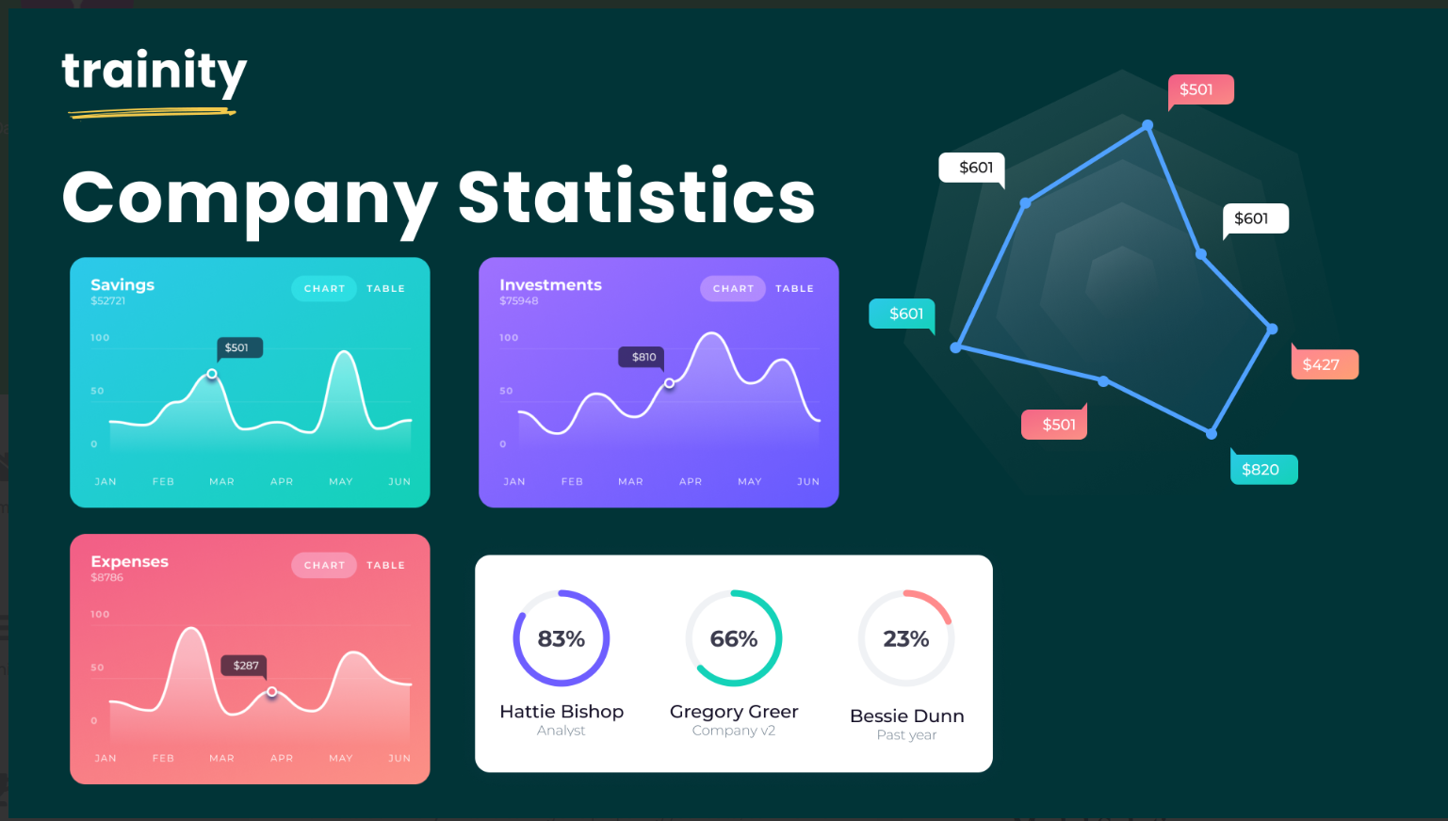
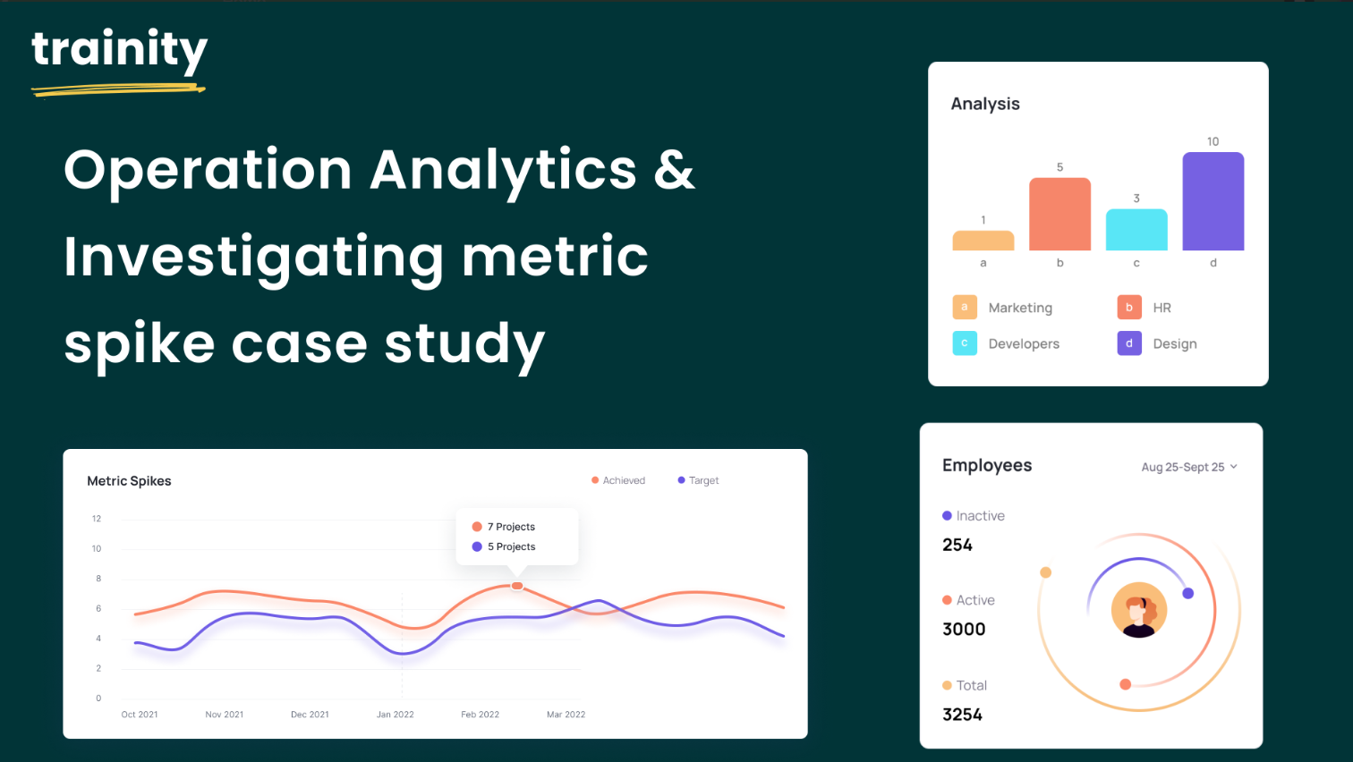

Slide 2
Hiring Process Analytics
Description: In competitive marketing, hiring process analytics is a critical procedure. Hiring process analytics involves the systematic collection, measurement, and interpretation of data related to the various stages of recruitment and selection within an organization.
Through the analysis of key metrics such as time-to-hire, cost-per-hire, source of hire, candidate diversity, and applicant drop-off rates, hiring process analytics help organizations identify bottlenecks, streamline procedures, and make informed decisions to optimize their recruitment strategies. In a competitive job market, utilizing hiring process analytics becomes imperative for organizations seeking to attract and retain top talent while maintaining operational excellence.

Slide 3
Approach :
Handling Missing Data: Check if there are any missing values in the dataset. If there are, decide on the best strategy to handle them.
Clubbing Columns: If there are columns with multiple categories that can be combined, do so to simplify your analysis.
Outlier Detection: Check for outliers in the dataset that may skew your analysis.
Removing Outliers: Decide on the best strategy to handle outliers. This could be removing them, replacing them, or leaving them as is, depending on the situation.
Data Summary: After cleaning and preparing your data, summarize your findings. This could involve calculating averages, medians, or other statistical measures. It could also involve creating visualizations to better understand the data.

Slide 4
Tech used :
Microsoft Excel: To explore, analyze, and visualize the data.
Objectives:
Hiring Analysis
Salary Analysis
Salary Distribution
Departmental Analysis
Position Tier Analysis

Slide 5
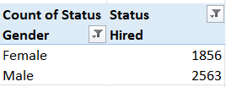
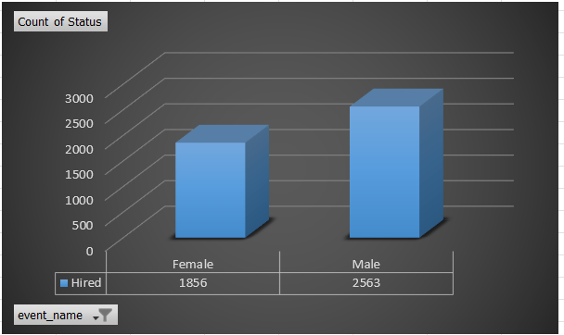
Hiring Analysis:
The hiring process involves bringing new individuals into the organization for various roles.
Task: Determine the gender distribution of hires. How many males and females have been hired by the company?
Observation: According to the data, the company hired 2563 men and 1856 women. Males were hired in greater numbers than females.

Slide 6
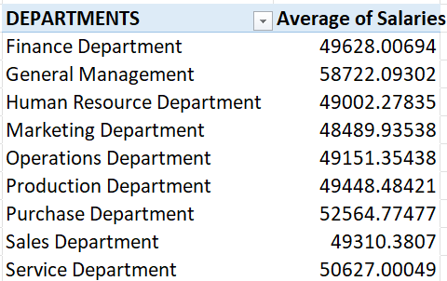
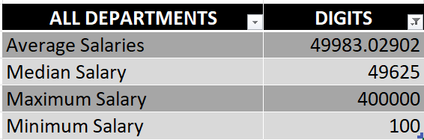
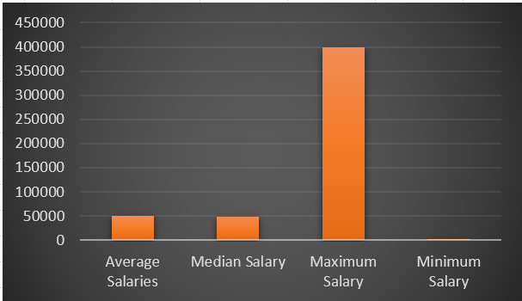
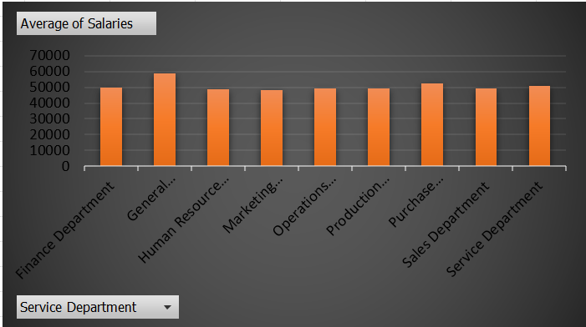
Salary Analysis: The average salary is calculated by adding up the salaries of a group of employees and then dividing the total by the number of employees.
Task: What is the average salary offered by this company? Use Excel functions to calculate this.
Observation: According to the data, the average salary for all departments combined is 49983.02902, the max salary is 400000, and the min salary is 100.

Slide 7
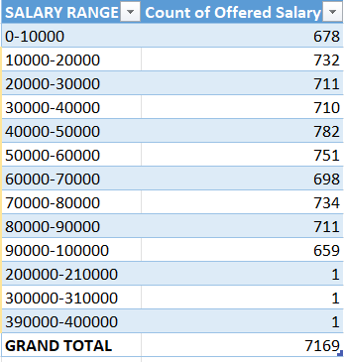
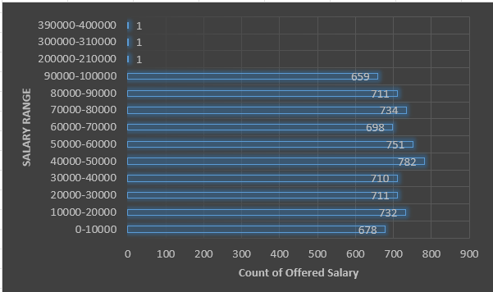
Salary Distribution:
Class intervals represent ranges of values, in this case, salary ranges. The class interval is the difference between the upper and lower limits of a class.
Task: Create class intervals for the salaries in the company. This will help you understand the salary distribution.

Slide 8
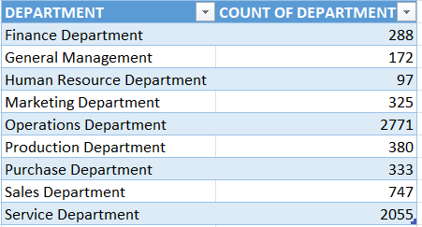
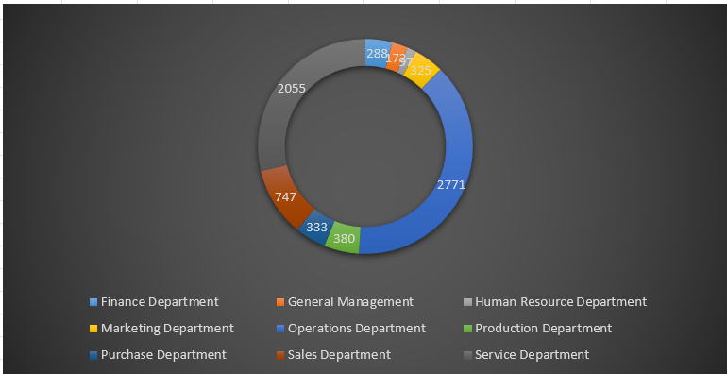
Departmental Analysis:
Visualizing data through charts and plots is a crucial part of data analysis.
Task: Use a pie chart, bar graph, or any other suitable visualization to show the proportion of people working in different departments.
Observation: Operations Department has the most employees total of 2771 and the Human Resources the lowest 97 Employees.

Slide 9
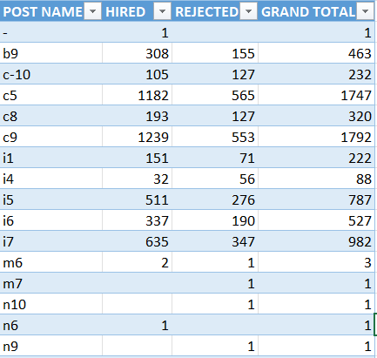
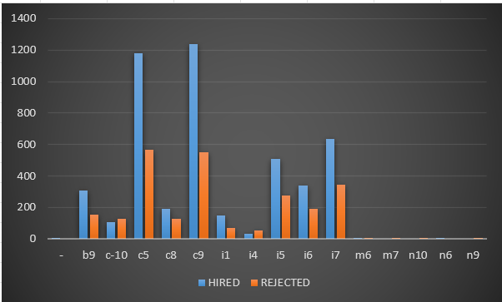
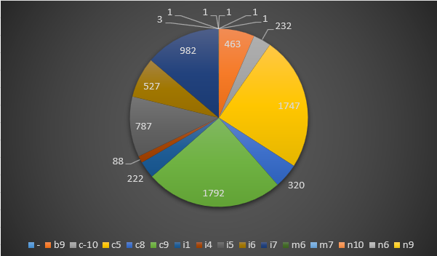
Position Tier Analysis:
Different positions within a company often have different tiers or levels.
Task: Use a chart or graph to represent the different position tiers within the company. This will help you understand the distribution of positions across different tiers.
Observation: Most of the employees are in the post tier of c9 a total of 1792 Employees out of which 1239 are hired and 553 are rejected.

Slide 10
Insights:
1)According to the data, the company hired 2563 men and 1856 women. Males were hired in greater numbers than females, i.e., 57.9996% are males and 42% are females.
2) According to the data, the average salary for all departments combined is 49983.02902, the
maximum salary is 400000, and the minimum salary is 100. General management has the highest
average salary of 58772.09, and the marketing department has the lowest average salary of
48489.93.
3) Most of the employee’s salary class interval is between 40000 and 50000.
4) The Operations Department has the most employees, totaling 2771, and Human Resources has the lowest, with 97 employees. That is, 38.6% of all employees work in the operations department, and 1.3% work in the human resources department.
5) Most of the employees are in the post tier of c9 a total of 1792 Employees out of which 1239 are hired and 553 are rejected.

Slide 11
Thank You
Excel Link

